Slide 1

Predicting Airplane Delays — From On-Prem Modeling to Cloud Deployment
David Sun
Notes:
Hello everyone, my name is David Sun, and today I’ll present my project titled “Predicting Airplane Delays.” This project comes from a real-world scenario of a travel booking website that wants to improve customer experience by warning users — at the time of booking — if a flight is likely to be delayed, especially due to weather conditions, for the busiest U.S. domestic airports. The project demonstrates an end-to-end workflow, from data collection and cleaning, to EDA, feature engineering, local modeling, cloud training using AWS SageMaker, model evaluation, and visualization in Tableau.

Slide 2

Dataset & Problem Definition
The data comes from the U.S. Bureau of Transportation Statistics (BTS) On-Time Performance records between 2014 and 2018, comprising 60 monthly files. Filtered the top 9 busiest airports — ATL, ORD, DFW, DEN, CLT, LAX, IAH, PHX, and SFO — and the top 5 airlines — UA, OO, WN, AA, and DL. After merging, the dataset contained about 1.66 million rows × 20 columns. The target variable is is_delay, indicating whether a flight’s arrival delay exceeded 15 minutes. Because about 80% of flights are on time and only 20% delayed, I evaluated models not only by accuracy but also by recall, precision, F1-score, and specificity.

Slide 3
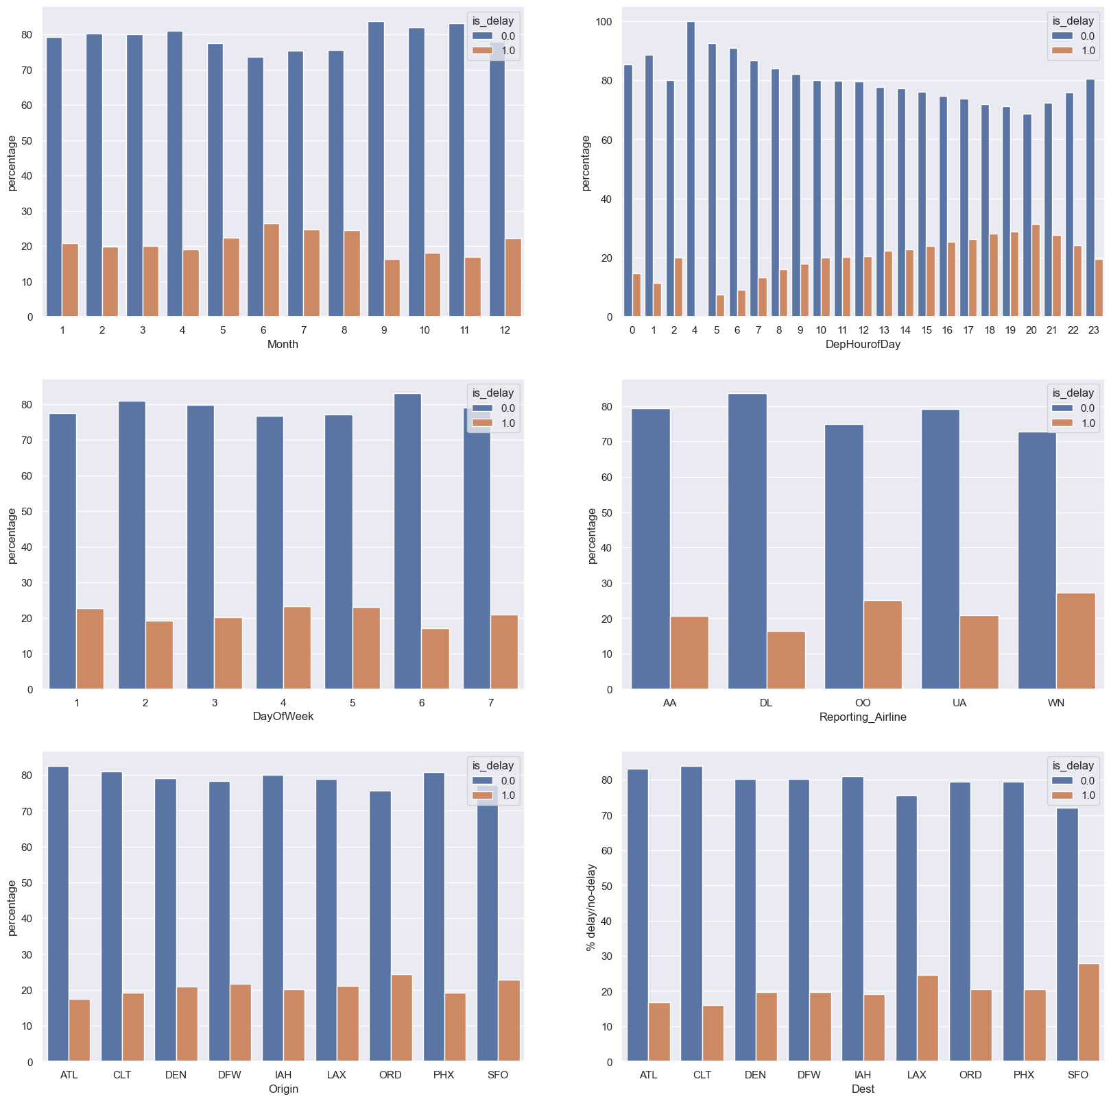
Patterns and Seasonality
Exploratory Data Analysis revealed clear patterns:
Months: June to August have the highest delay rates; September is the lowest.
Time of Day: Delays peak from 3 PM to 8 PM, while early-morning flights rarely delay.
Day of Week: Thursdays see more delays, Tuesdays the least.
Airlines / Airports: WN and OO have higher delay ratios; ORD and SFO stand out as major bottlenecks. These findings directly inform risk-based alert design and operational buffer strategies.

Slide 4
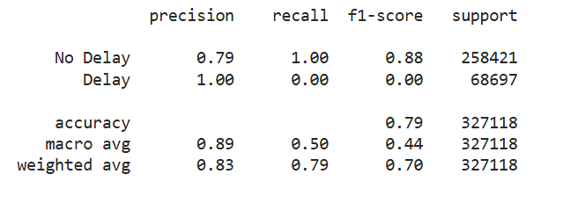
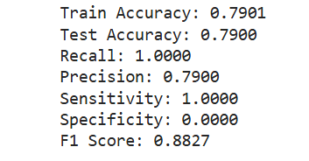
Iteration I – Logistic Regression Baseline
First engineered time features (Month, Day of Week, Departure Hour), categorical encodings for airline and airport, and distance, yielding
Using a Logistic Regression classifier with an 80/20 train-test split:
Overall accuracy was around 0.79,
but the recall for delayed flights was almost zero. The model was heavily biased toward the majority class (“on time”), so it failed to meet the business goal of catching delays. This motivated a second iteration with stronger features and more complex models.

Slide 5
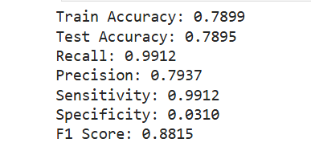
Iteration II – Holidays and Weather Features
To improve the model, added two categories of features:
Holiday flag indicating U.S. federal holidays (2014–2018).
Weather variables — average wind speed (AWND), precipitation (PRCP), temperature (TAVG), and snow (SNOW) — for each origin and destination airport, with missing values imputed by station × month averages. The feature space expanded to about 102 columns, forming combined_csv_v2.csv. Local Logistic Regression showed slightly better specificity (0 to ≈ 3%) but delay recall was still poor. Therefore, I moved the enhanced dataset to AWS SageMaker for scalable experimentation.

Slide 6
Data Preparation
The first step was data cleaning and preparation
Removed missing values using dropna() and confirmed that all remaining columns were complete. After cleaning, the dataset contained 94 columns with no missing values.
Split the dataset into:70% for training/15% for validation/15% for testing
I also checked that the target variable, called “target,” was well-balanced. About 25% of flights were delayed, and 75% were on time.
All data files were uploaded to Amazon S3, so SageMaker could access them for training.

Slide 7
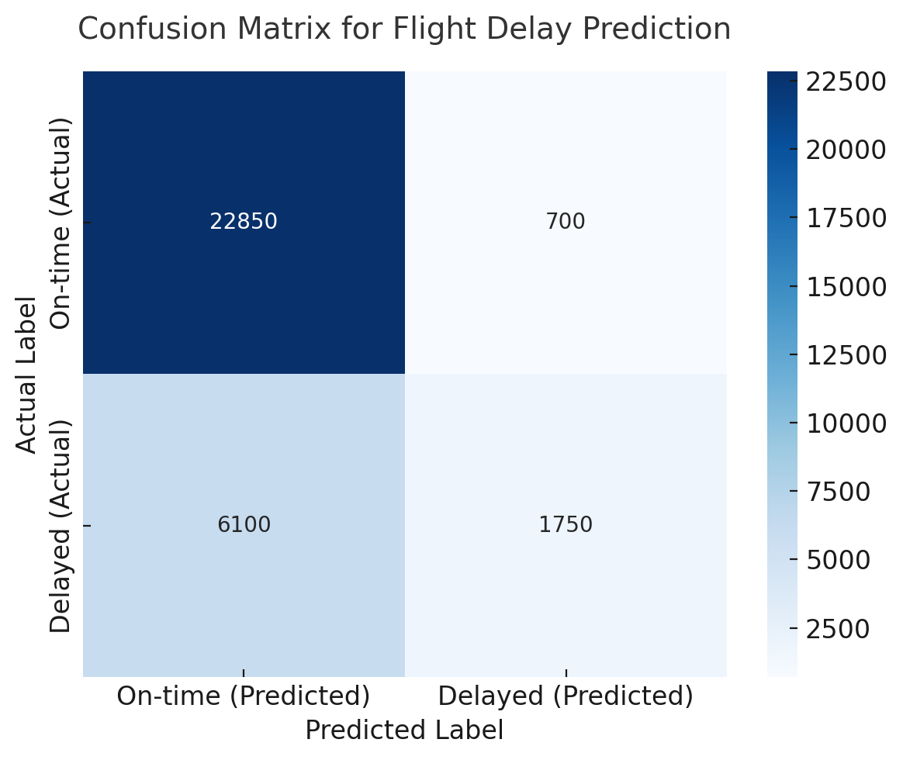
Linear Learner model,
To start, I used a Linear Learner model, which is a simple binary classifier in SageMaker.
Trained it with 5 epochs and a mini-batch size of 256. After training, I deployed the model and evaluated it on the test data using Batch Transform.
Here are the key results:
Accuracy: 0.77 Precision: 0.63 Recall: 0.15 F1 Score: 0.23 ROC AUC: 0.70
The confusion matrix showed that the model correctly identified most on-time flights but missed many delayed ones.
This means the model was biased toward predicting flights as on-time, likely because the dataset is imbalanced.

Slide 8
Ensemble Model (XGBoost) and Evaluation
To further improve performance, I used an ensemble learning model – XGBoost. Here are the main hyperparameters I used:
Objective: binary:logistic
Number of rounds: 75
Maximum depth: 5
Learning rate (eta): 0.15
Subsample ratio: 0.7

Slide 9
Ensemble Model (XGBoost) and Evaluation
After training, I evaluated the model on the test dataset, and the results were as follows:
Accuracy: 0.79
Precision: 0.68
Recall: 0.24
F1 Score: 0.35
ROC AUC: 0.75
From these results, we can see that XGBoost clearly outperformed the Linear Learner model. The confusion matrix showed that it correctly identified more delayed flights, and its predictions were much more balanced between on-time and delayed classes, making it more reliable for real-world use.

Slide 10
Insights and Interpretation
From these results, we can make several key observations:
Linear Learner is simple and fast but struggles with class imbalance.
XGBoost performs better because it captures more complex patterns.
The improvement in recall and AUC means the model is now more reliable for real-world prediction.
The trade-off is a slightly longer training time, but the accuracy gain makes it worthwhile.

Slide 11
Future Improvement
Add feature engineering — for example, include weather severity, time of year, and airport traffic level
Use SMOTE or class weighting to handle imbalance between delayed and on-time flights.

